Slide 1
Becoming American:
From Johann Hermann Moehlenkamp
to Taylor Swift (in only 7 Generations)
Walter D. Kamphoefner
waltkamp@tamu.edu

Slide 2
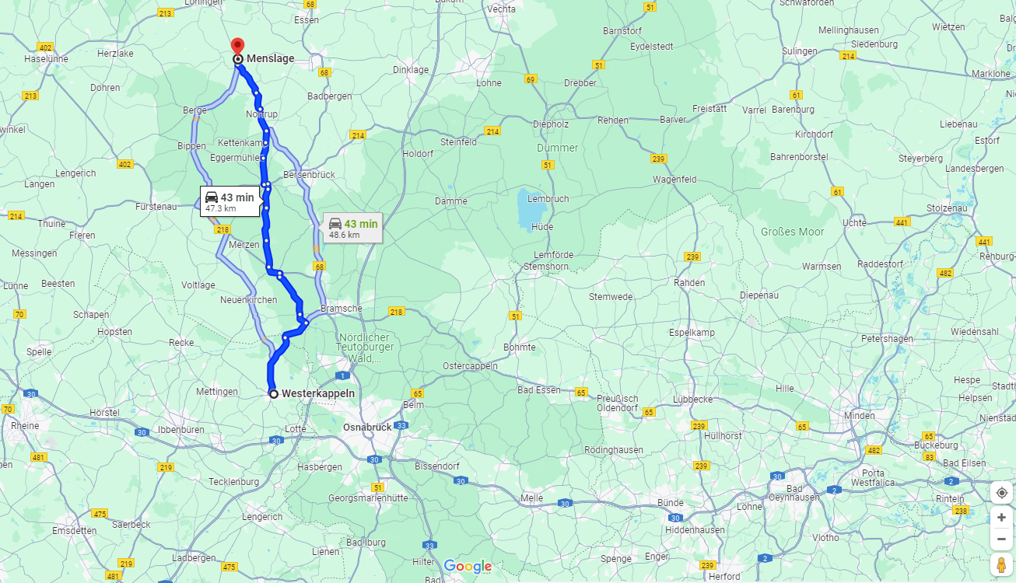

Slide 3
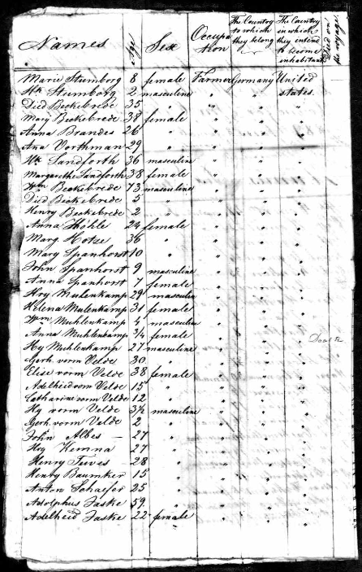
A page from the 1836 passenger list of the Oelbers, with a number of typical St. Charles Lutheran names: Stumberg, Bekebrede, Brandes, Vorthmann, Sandfort, Hotze Spanhorst, Moehlenkamp, VormVelde, Baumker, Schaefer, Faske. They weren’t very diligent about recording occupations or place or origin or destination.

Slide 4
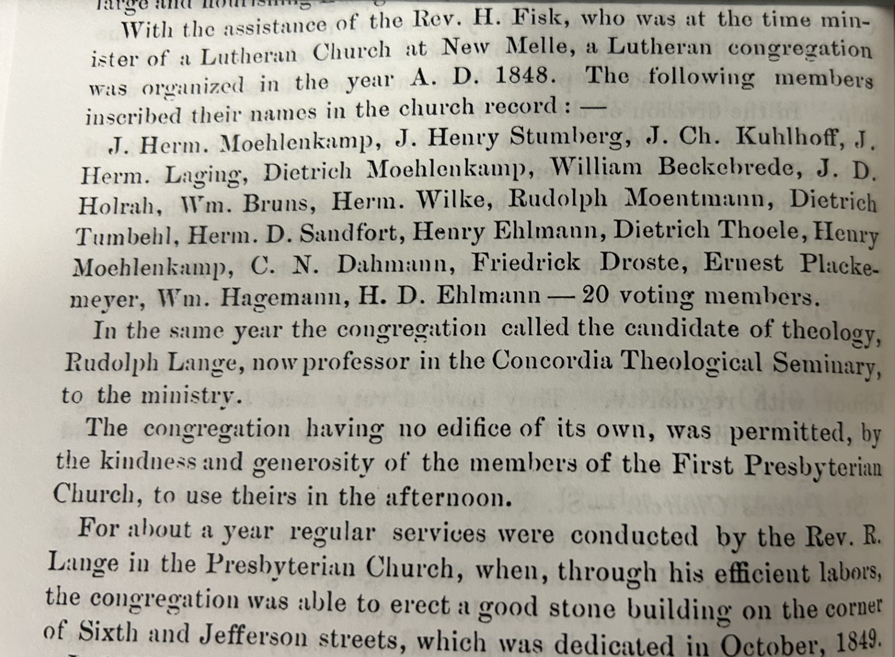
An account of the founding of Immanuel Lutheran Church, St. Charles, in the 1885 County History

Slide 5
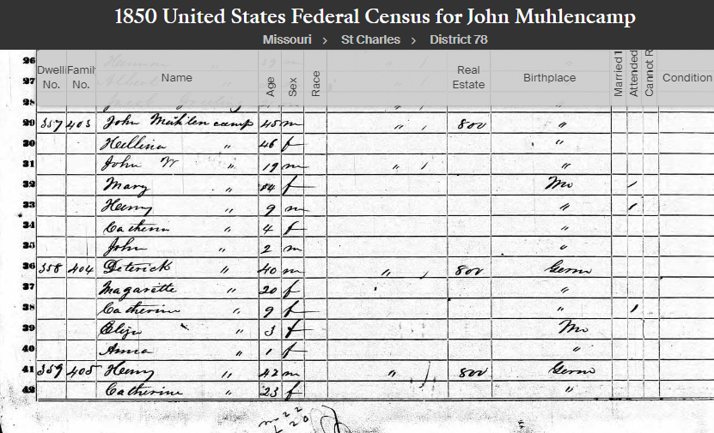

Slide 6
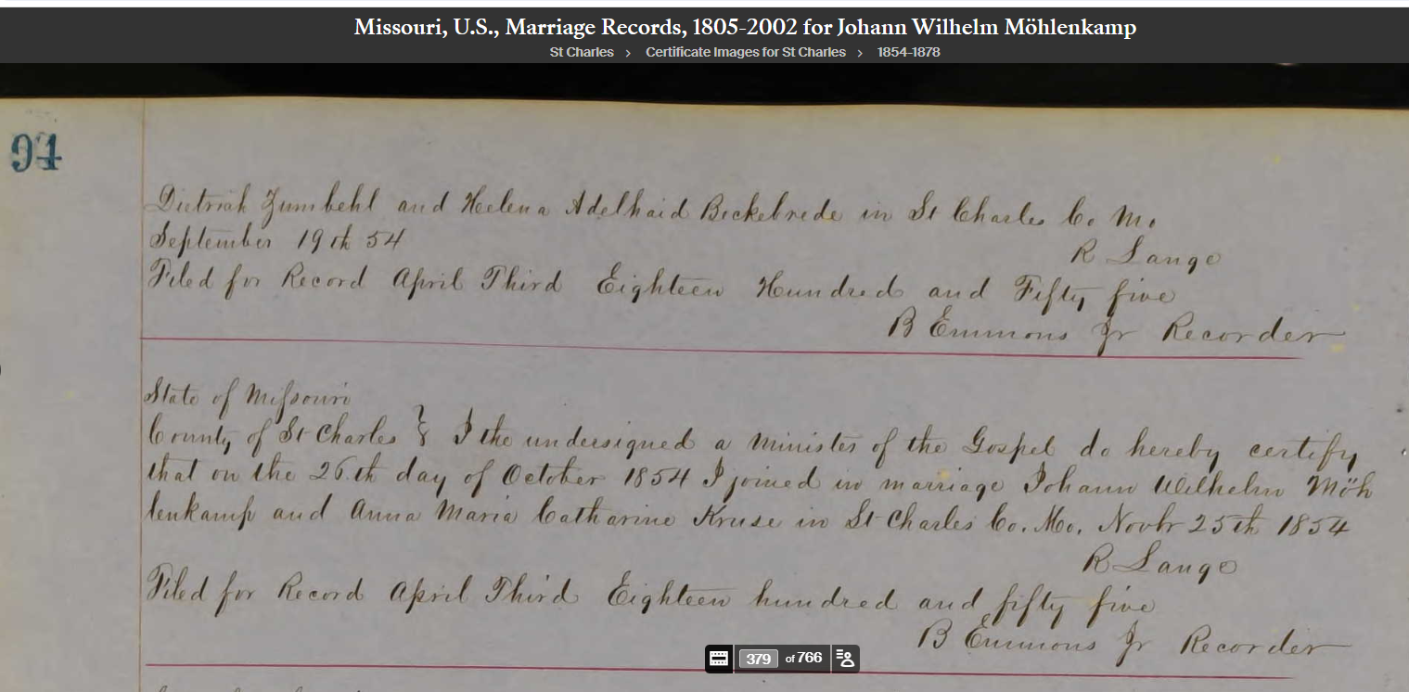
Johann Wilhelm Möhlenkamp and Anna Maria Catherine Kruse were married on October 25, 1854 by R. Lange

Slide 7
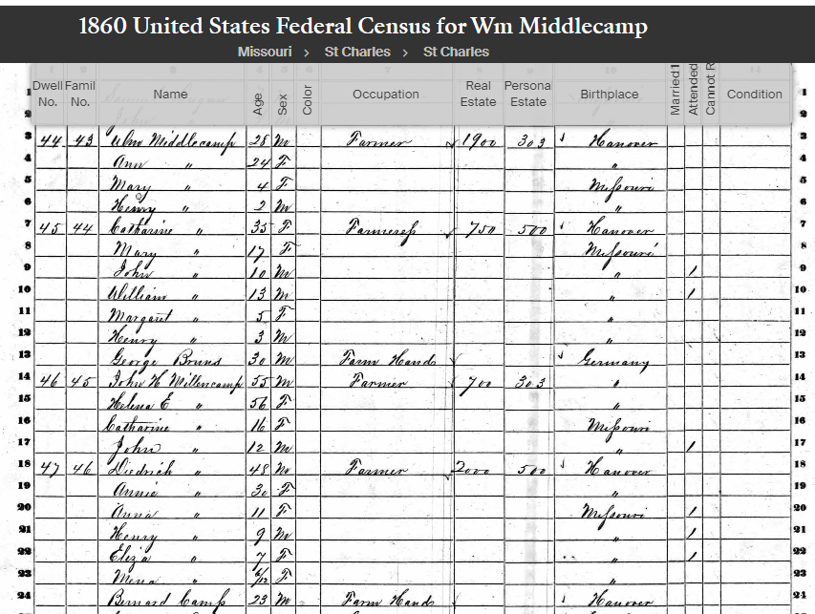

Slide 8
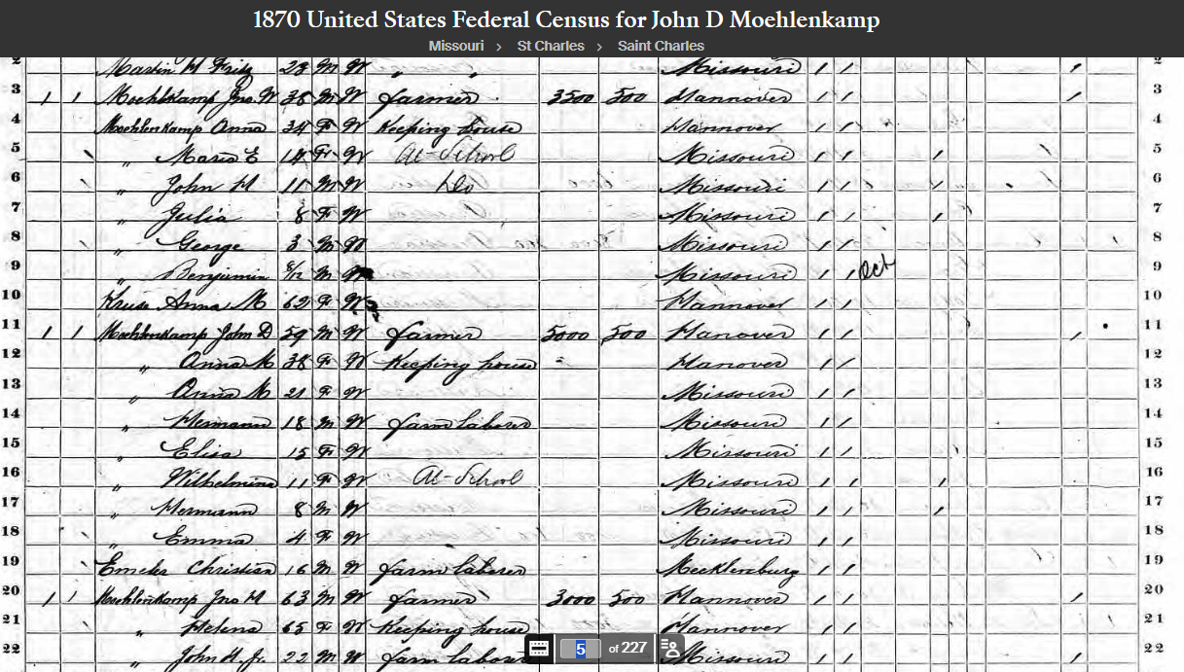

Slide 9
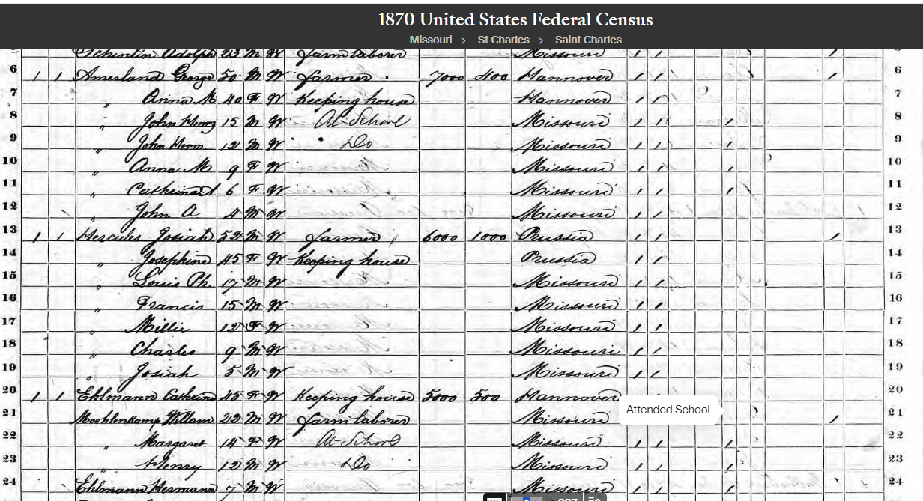

Slide 10
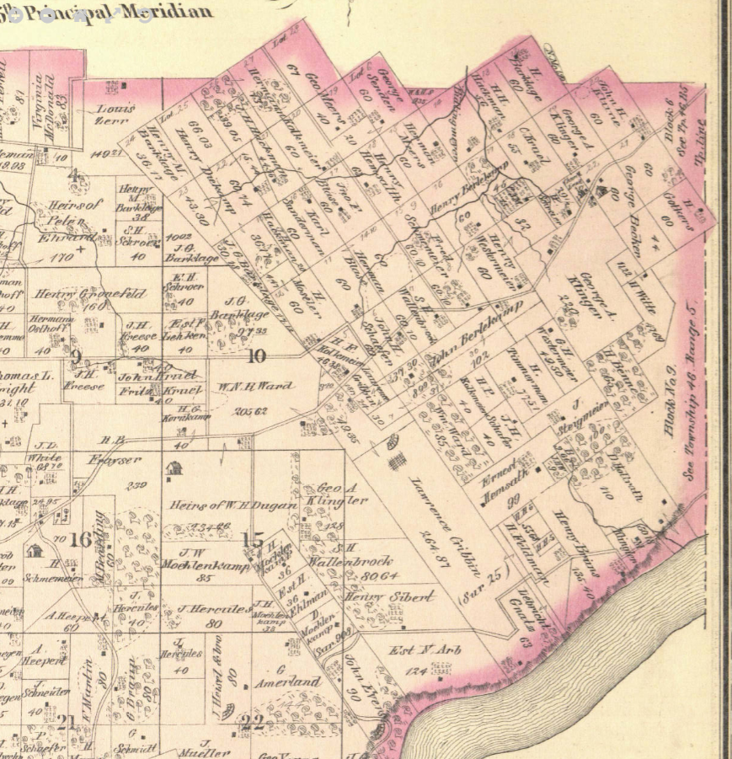
The 1875 County Plat Book shows three 36-acre plots in Survey 308 owned by the three Moehlenkamp brothers in 1850, each valued then at $800, because of the proximity to St. Charles. J.W. [William] Moehlenkamp of the second generation owned an adjacent 85 acres. The numbered sections are each a square mile, so they were only about 4 miles from Friedens Evangelical Church, which is only a mile or two outside the city limits. By 1875, Johann Hermann and Dietrich still owned their parcels, but the widow of Henry had remarried to and Ehlmann and was widowed again. The road to the left of their plots is Jungs Station Road. The house symbol just left of section #16 is at Harvester. By the 1905 Plat Book, none of this land was owned by Moehlenkamps, but Dietrich Ehlmann owned the 85 acres.
Friedens Ev. Church
Moehlenkamps

Slide 11
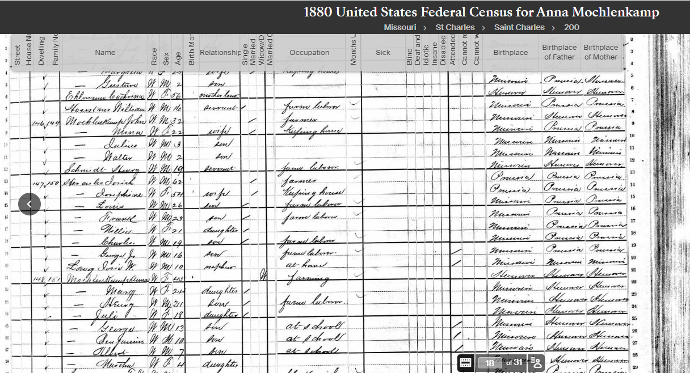

Slide 12
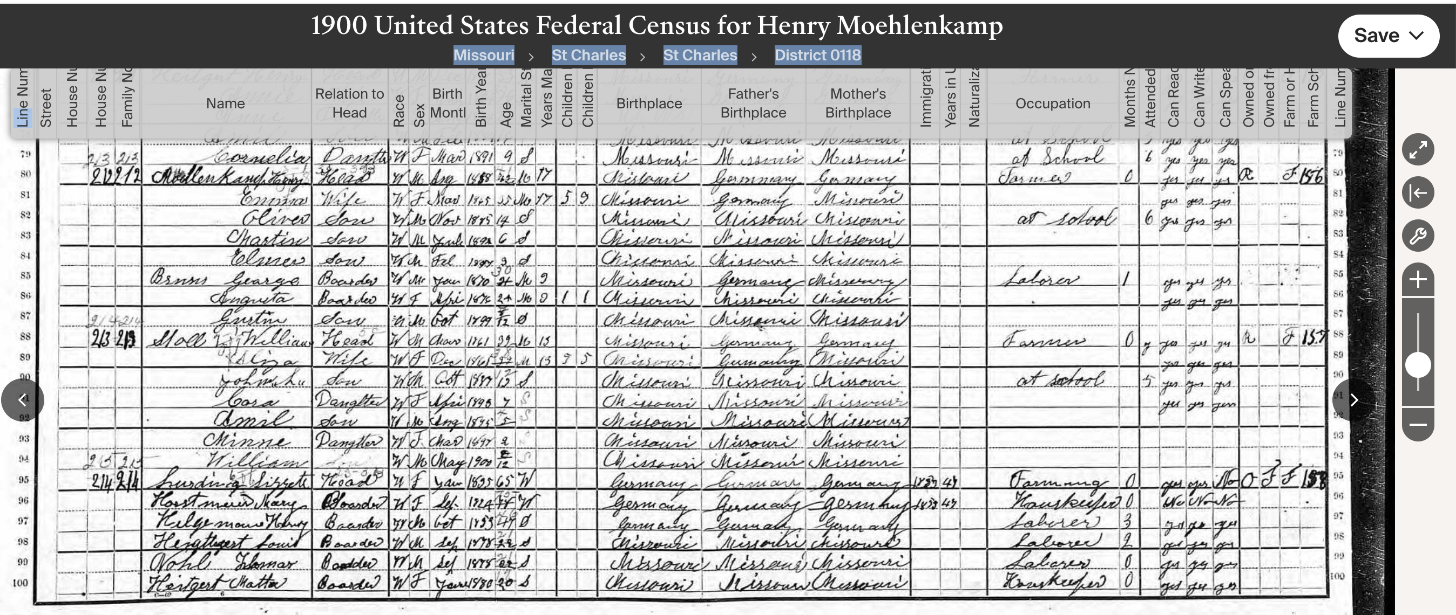
Missouri
St Charles
St Chales

Slide 13
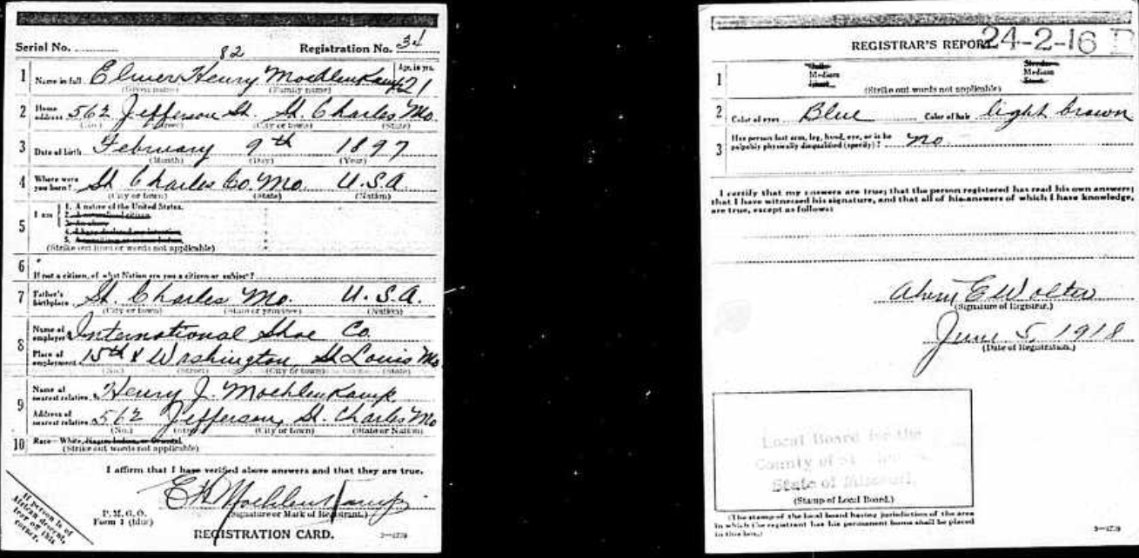
World War I draft registration of Marjorie’s father Elmer Henry Moehlenkamp, then working for International Shoe Company in St. Louis. Maybe this is where Taylor gets her blue eyes.

Slide 14
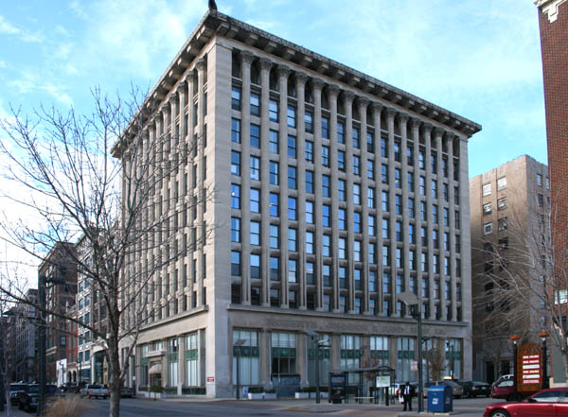
Elmer worked here, the International Shoe Building. As of 2018, a developer was in the process of turning it into a luxury hotel which opened the following year.

Slide 15
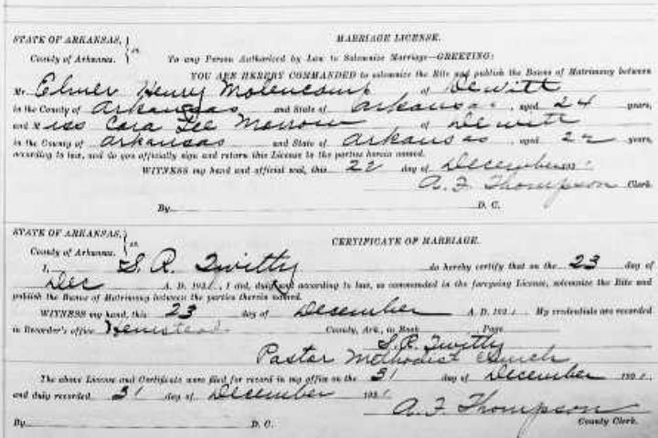
Marriage Record of Marjorie Moellenkamp’s Parents, 12/23/1921

Slide 16
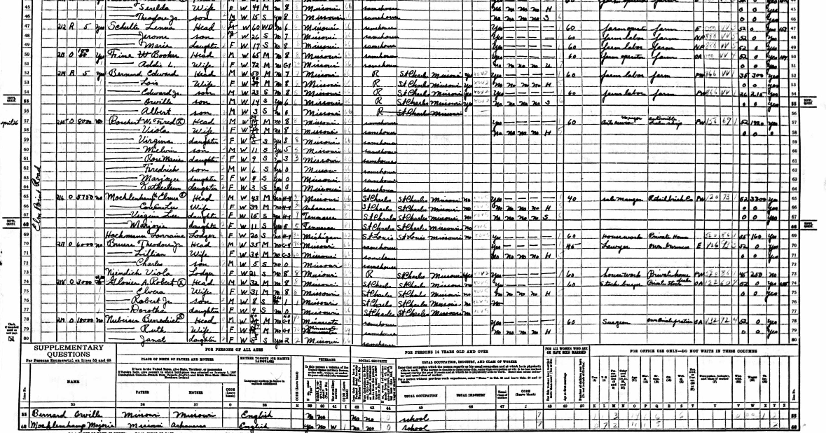
Line 65 ff.: Marjorie Moehlenkamp with parents and sister in the 1940 census. Father sales manager, retail brick co.

Slide 17
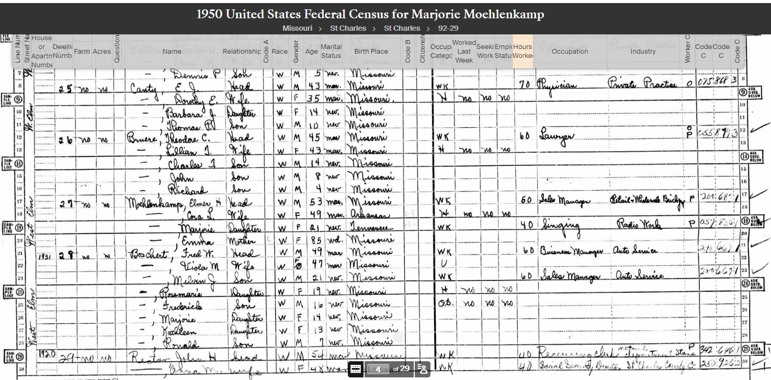

Slide 18
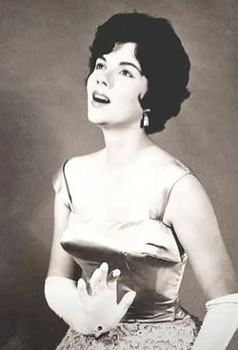
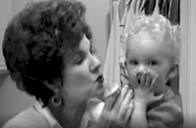
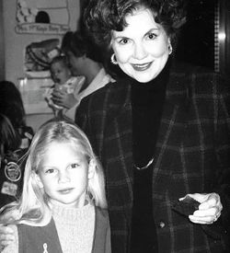
Marjorie had a flair for the dramatic just like her granddaughter, whose career she never witnessed.

